Slide 1
Laboratory Presentation
Name
Institution
Date

Slide 2
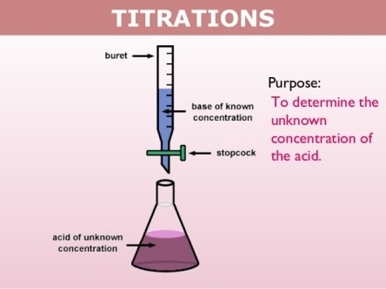
Introduction
Titration is essential in determining the concentration of substances, especially the known ones.
There are different types of titration including acid-base titration and back titration that help in determining the concentration of substances.
Kiani (2018) mentioned that acid-base titration is an experimental method of determining the unknown concentration of an acid or a base of a known concentration.
With the knowledge on acid-base titration, a person is capable of applying the knowledge in different sectors, especially those that deal with chemicals.
Notes:
Titration is essential in determining the concentration of substances, especially the known ones. There are different types of titration including acid-base titration and back titration that help in determining the concentration of substances. Kiani (2018) mentioned that acid-base titration is an experimental method of determining the unknown concentration of an acid or a base of a known concentration. With the knowledge on acid-base titration, a person is capable of applying the knowledge in different sectors, especially those that deal with chemicals.

Slide 3
Importance of Understanding Acid-base Titration
Scientists use the knowledge on acid-base titration in calculating the pH substances with the aid of an indicator.
There are many industries that apply the knowledge on acid-base titration. For example, in water purification plants, titration is applied in identifying the presence of contaminants like heavy metals (Pierre, 2019).
The food industries need to confirm if the food they are offering to their consumers is of high quality and acid-base titration helps in that.
With acid-base titration, the equivalent points and determined this is a neutral point since the reactants have equal volumes.
Notes:
Scientists use the knowledge on acid-base titration in calculating the pH substances with the aid of an indicator. There are many industries that apply the knowledge on acid-base titration. For example, in water purification plants, titration is applied in identifying the presence of contaminants like heavy metals (Pierre, 2019). The food industries need to confirm if the food they are offering to their consumers is of high quality and acid-base titration helps in that. With acid-base titration, the equivalent points and determined this is a neutral point since the reactants have equal volumes (Pierre, 2019).

Slide 4
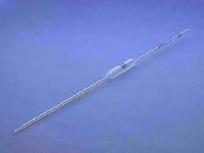
Apparatus
In this acid-base titration, acetic acid will be used and sodium hydroxide.
Apparatus
Burette, 50 cm3
Pipette, 25 cm3
Conical flask, 100 cm3
Beaker cm3
Stand and clamp
Funnel
White tile
Dropper
Notes:
In this acid-base titration, acetic acid will be used and sodium hydroxide. The apparatus includes; Burette, 50 cm3, Pipette, 25 cm3, Conical flask, 100 cm3, Beaker cm3, Stand and clamp, Funnel, White tile, and Dropper. The reagents are NaOH of 0.1054 M, Acetic, 5.00 ml, and Phenolphthalein indicator.

Slide 5
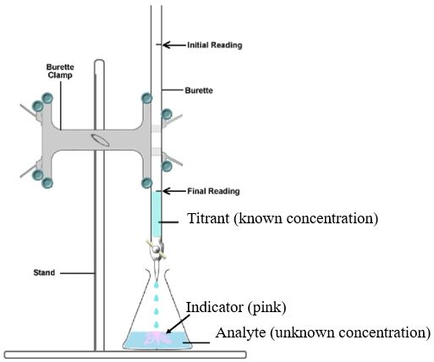
Reagents
NaOH of 0.1054 M
Acetic, 5.00 mL
Phenolphthalein indicator

Slide 6
Procedure
Place the 50cm3 burette on a stand and clamp, adjust it to your size then using and funnel fill the burette with acetic acid up to the zero mark.
Pipette 25cm3 of NaOH in a conical flask and place it on white tile.
Add exactly three drops of phenolphthalein indicator to the NaOH in the conical flask.
Using acetic acid, titrate the NaOH as you swirl the conical flask till the solution becomes colorless.
Repeat the procedure twice and record the results. Use the data collected for calculations.
Notes:
Place the 50cm3 burette on a stand and clamp, adjust it to your size then using and funnel fill the burette with acetic acid up to the zero mark. Pipette 25cm3 of NaOH in a conical flask and place it on white tile. Add exactly three drops of phenolphthalein indicator to the NaOH in the conical flask. Using acetic acid, titrate the NaOH as you swirl the conical flask till the solution becomes colorless. Repeat the procedure twice and record the results. Use the data collected for calculations.

Slide 7
Results
Results
 | Initial NaOH Volume (ml) | Final NaOH volume (ml) | Total Volume of NaOH used (ml)
Trial 1 | 8.59 | 0.20 | 8.39
Trial 2 | 9.20 | 1.00 | 8.20
Trial 3 | 9.20 | 2.01 | 7.19
The average volume is; 8.39 + 8.20 + 7.19 = 23.78
23.78 3 = 7.9267 ml. The titre volume is calculated by dividing the total volumes from the three runs and then dividing by three.
Notes:
The average volume is; 8.39 + 8.20 + 7.19 = 23.78
23.78 3 = 7.9267 ml. The titre volume is calculated by dividing the total volumes from the three runs and then dividing by three.

Slide 8
The Concentration of Acetic Acid
The volume of NaOH is 7.9267 ml
A balanced chemical equation
CH2COOH (aq) + NaOH (aq) → CH3COONa (aq) + H2O(l).
The mole ration of NaOH to CH2COOH is 1: 1
The moles of NaOH used in the titration are;
0.1054 M/L x 0.0079267 L = 0.00083547418 moles
The mole ratio is 1:1 and thus the moles of CH2COOH is 0.00083547418.
The concentration of CH2COOH in the 5.00 ml sample
Molarity of CH2COOH = 0.00083547418 moles / 0.005 = 0.1671 M
Notes:
The volume of NaOH is 7.9267 ml. From the balanced chemical equation, the mole ration of NaOH to CH2COOH is 1: 1. The moles of NaOH used in the titration are calculated by; 0.1054 M/L x 0.0079267 L = 0.00083547418 moles
The mole ratio is 1:1 and thus the moles of CH2COOH is 0.00083547418.
The concentration of CH2COOH in the 5.00 ml sample
Molarity of CH2COOH = 0.00083547418 moles / 0.005 = 0.1671 M

Slide 9
References
Kiani, M. J. E. (2018). U.S. Patent Application No. 15/794,838.
Pierre, D. (2019). Acid-Base Titration. Undergraduate Journal of Mathematical Modeling: One+ Two, 10(1), 8.

